Slide 1
FIFO Depth Calculation
By sravanthi
Chipweave technologies PVT LTD

Slide 2
Contents
INTRODUCTION
DEFINITIONS
FIFO DEPTH CALCULATION

Slide 3
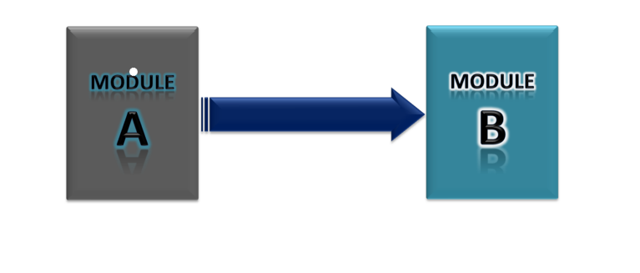
INTRODUCTION
The depth (size) of the FIFO should be in such a way that, the FIFO can store all the data which is not read by the slower module.
FIFO depth will be equal to the no. of data items that are left without reading.
The following examples describe the different possible scenarios in which Asynchronous FIFO is required. In the following examples, I considered that, the module ‘A’ wants to send some data to the module ‘B’

Slide 4
DEFINITIONS
You need to know the burst rate, burst size, frequencies, etc. to determine the appropriate size of FIFO.
Burst size :How many data items come together in one burst
Example: 120 packets sent continuously → burst size = 120
Burst rate:How often bursts occur
Example:One burst every 1 ms
Write clock frequency (fA) → how fast data is written
Read clock frequency (fB) → how fast data is read

Slide 5
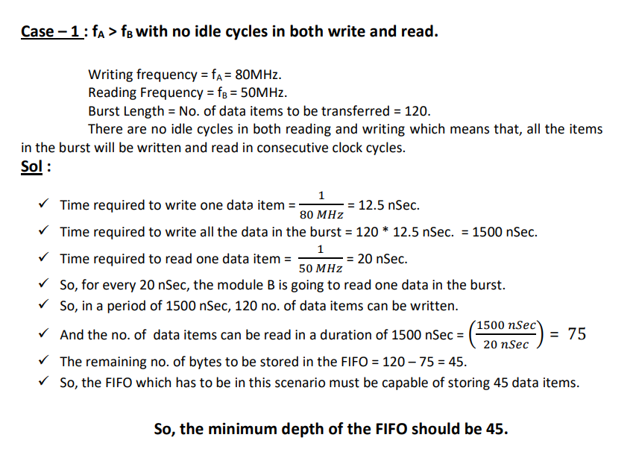
FIFO Depth Calculation FI

Slide 6
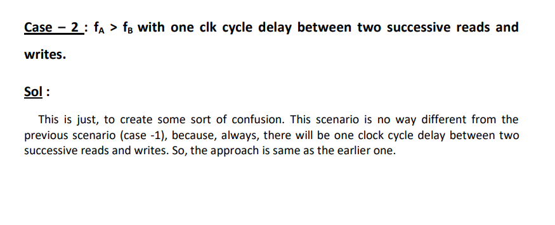
FIFO Depth Calculation(Contd..)

Slide 7
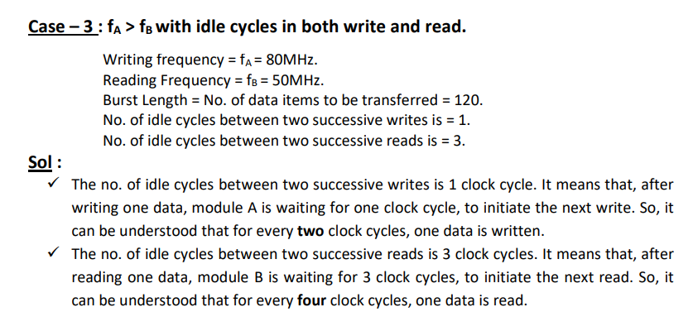
FIFO Depth Calculation(Contd..)

Slide 8
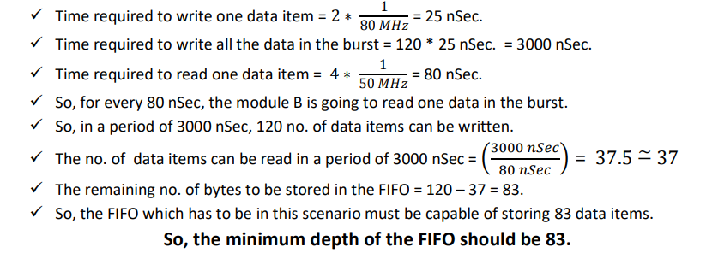
FIFO Depth Calculation(Contd..)

Slide 9
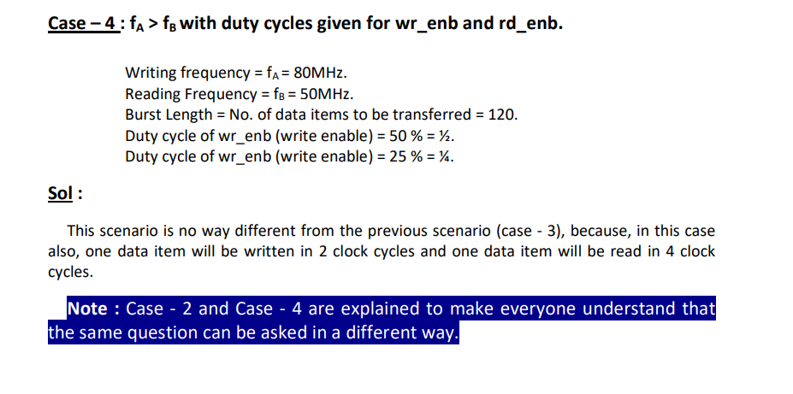
FIFO Depth Calculation(Contd..)

Slide 10
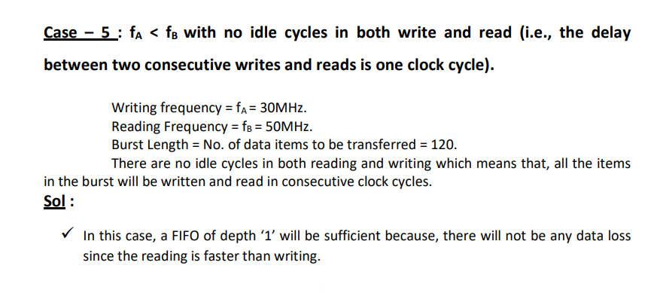
FIFO Depth Calculation(Contd..)

Slide 11
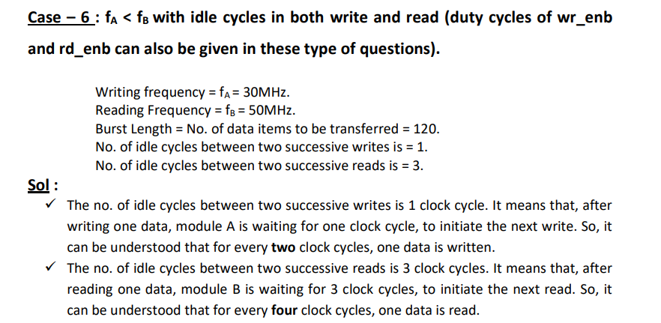
FIFO Depth Calculation(Contd..)

Slide 12
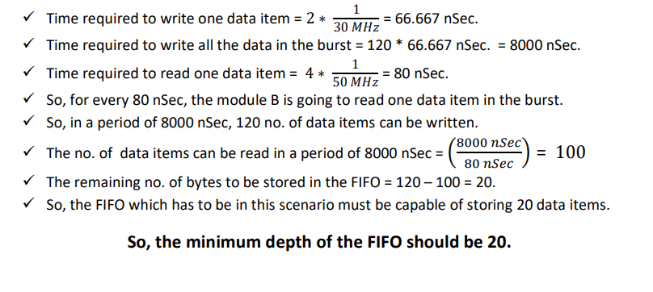
FIFO Depth Calculation(Contd..)

Slide 13
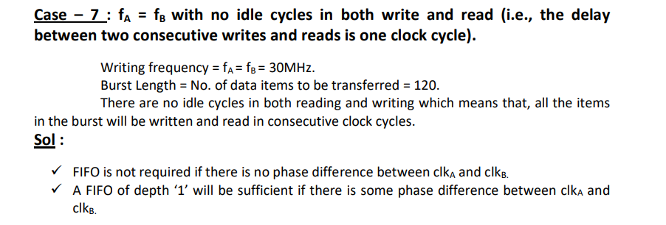
FIFO Depth Calculation(Contd..)

Slide 14
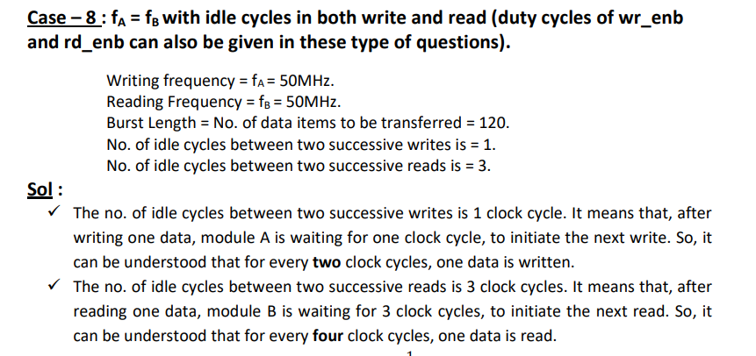
FIFO Depth Calculation(Contd..)

Slide 15
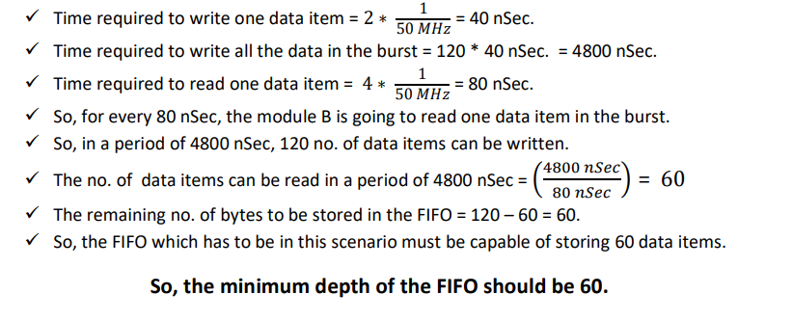
FIFO Depth Calculation(Contd..)

Slide 16
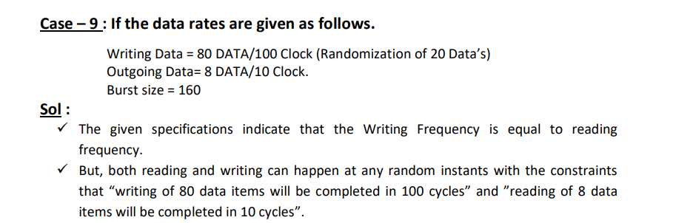
FIFO Depth Calculation(Contd..)

Slide 17
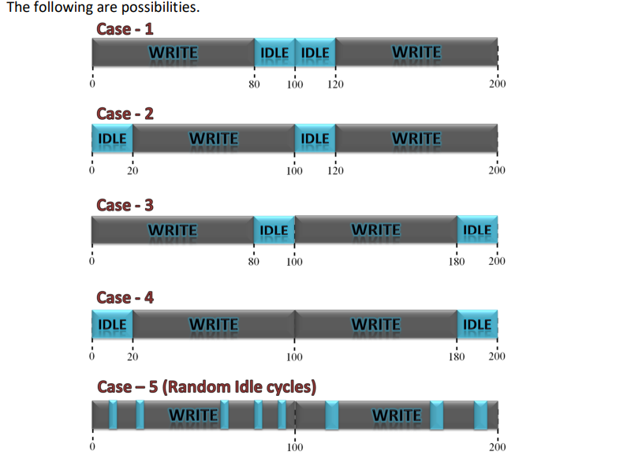
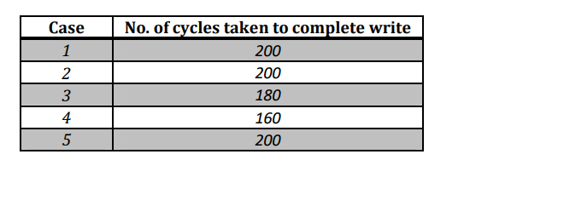
FIFO Depth Calculation(Contd..)

Slide 18
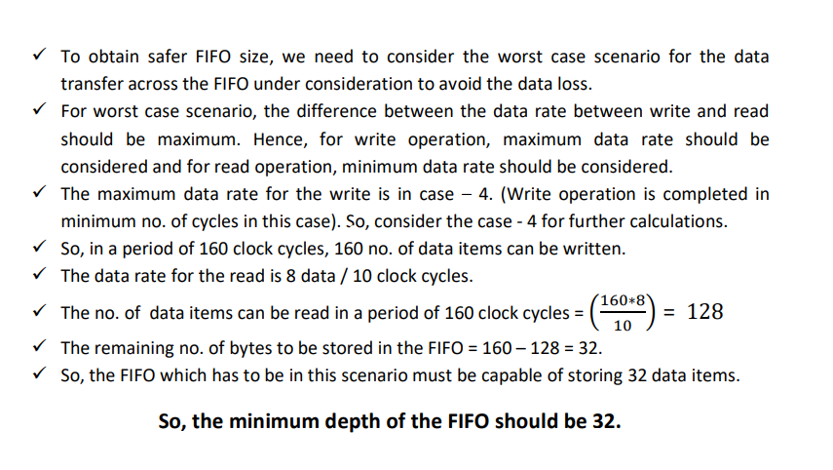
FIFO Depth Calculation(Contd..)

Slide 19
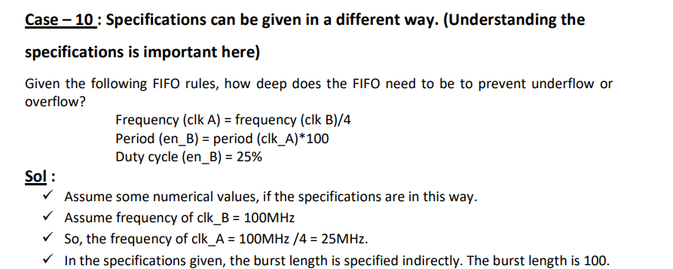
FIFO Depth Calculation(Contd..)

Slide 20
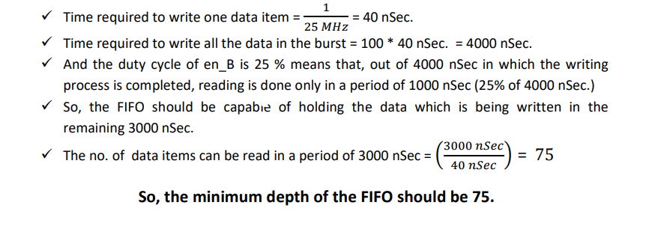
FIFO Depth Calculation(Contd..)

Slide 21


